Slide 1
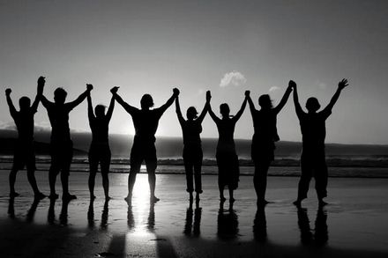
كن متأكداً
٢ تسالونيكي
د. ريك جريفيث • مؤسسة الدراسات اللاهوتية الأردنية
BibleStudyDownloads.org

Slide 2
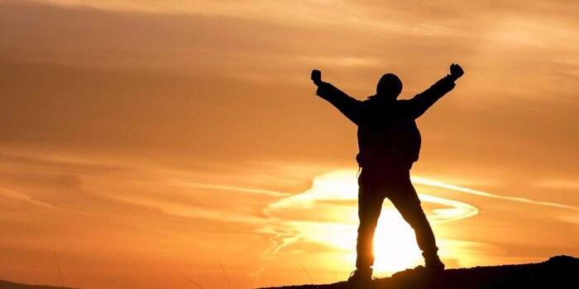
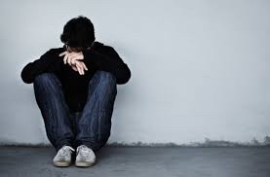
التأكيد
Notes:
Lately I have been thinking a lot about how we all need to be affirmed.
The past two weeks both Susan and I have had the most health issues ever in our 35-year marriage. Last Sunday was the first time we both ever missed church. My voice just wasn’t in shape to preach, I didn’t have the energy, etc. I won’t give you all the details lest it become “an organ recital.”
That’s not what is important. What is more significant is that some of you reached out to us and genuinely affirmed us! Thank you! Susan’s eye operation to correct her double vision did happen and was a success, despite our doubts about it going through with her rapid heartbeat days before the operation. Now, instead of seeing two husbands with her double vision, she is back to having only one husband.

Slide 3
مهمتنا
مهمة كنيسة الطرق المتقاطعة
هي الوصول إلى الأمم
من خلال الوصول إلى
الأجانب المقيمين في سنغافورة
Notes:
Let’s read this together…

Slide 4
رؤيتنا
تتمثل رؤية كنيسة الطرق المتقاطعة في قيادة الأجانب إلى علاقة حيوية مع يسوع المسيح كتلاميذ يمكنهم تحويل مجالات نفوذهم الفريدة (2 تيموثاوس 2: 2).
على وجه الخصوص ، تركز كنيسة الطرق المتقاطعة بشكل أساسي ، ولكن ليس حصريًا ، على الوصول إلى المجتمع الناطق باللغة الإنجليزية
Notes:
4
Reading together again…

Slide 5
أولوياتنا
محبة الأمم
محبة الكنيسة
محبة الله
Notes:
Essentially our chief priorities all revolve around love—to…
• Love God first and foremost, then…
• Love the church, resulting in…
• Love the nations

Slide 6
الكلمات تعطي تأكيد
Notes:
Curious about this concept of affirmation, I began looking up the word “affirmation” on Google to see what I could find.

Slide 7
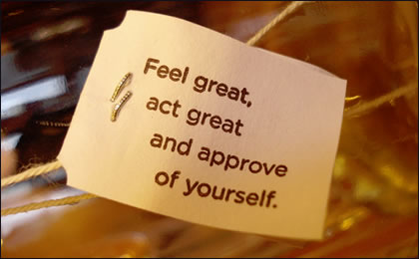
تأكيد الذات
Notes:
Hmmmm, should we approve of everything we do?

Slide 8
تأكيد الذات
Notes:
We are told to recite 1000 self-confidence affirmations!

Slide 9
تأكيد الذات
Notes:
Some self affirming claims include “I love me.”
Also, I believe in me.

Slide 10
تأكيد الذات
Notes:
How about “I am enough.”
Not to be outdone, another has modified it: “I am MORE THAN enough.”
Or I fill me mind with positive thoughts.

Slide 11
هل تأكيد الذات كافي ؟
WHO IS THE MOST AWESOME PERSON TODAY?
2 تسالونيكي
I LOVE MYSELF UNCONDITIONALLY

Slide 12
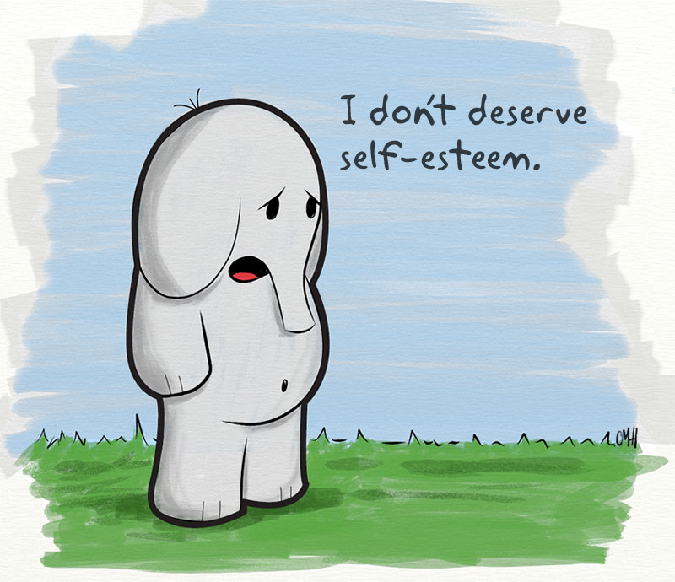
أنا لا استحق احترام الذات
Notes:
What if a person doubts that he or she deserves self-esteem?

Slide 13
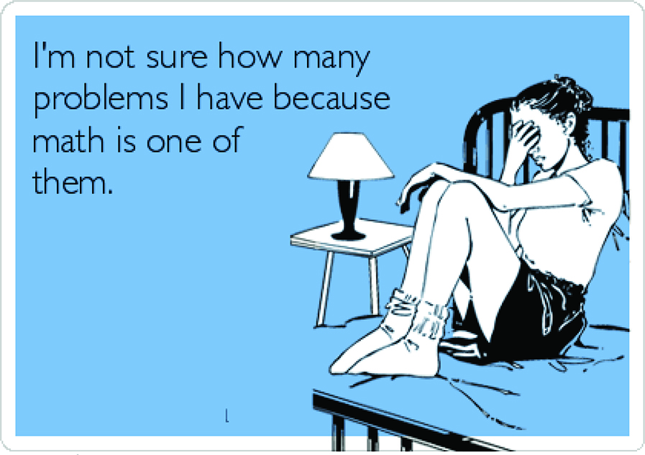
لست متأكدًا من عدد المشكلات التي أواجهها لأن الرياضيات إحداها.
Notes:
What do you do if you say, “I am not sure how many problems I have because math is one of them”?
Isn’t it far better for others to praise you than for you to praise yourself?

Slide 14
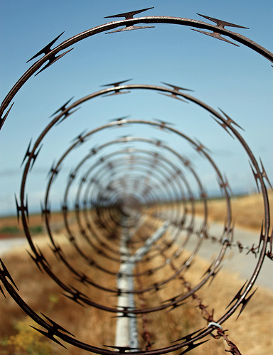
كم منا يلاحظ عندما يقع الآخرون في دوامة؟
Notes:
Love means seeing needs. I wonder how many of us have eyes to see when others have genuine needs—physical issues are easier to see, but spiritual needs are a greater challenge.
Life goes so fast, often it’s tough to take care of outselves let alone others. I struggle with this—don’t you? Do you struggle with how to help those who are in tough straits? Do you know anyone afflicted in their relationship with their spouse, in financial woe, struggling with children or work or something else?

Slide 15
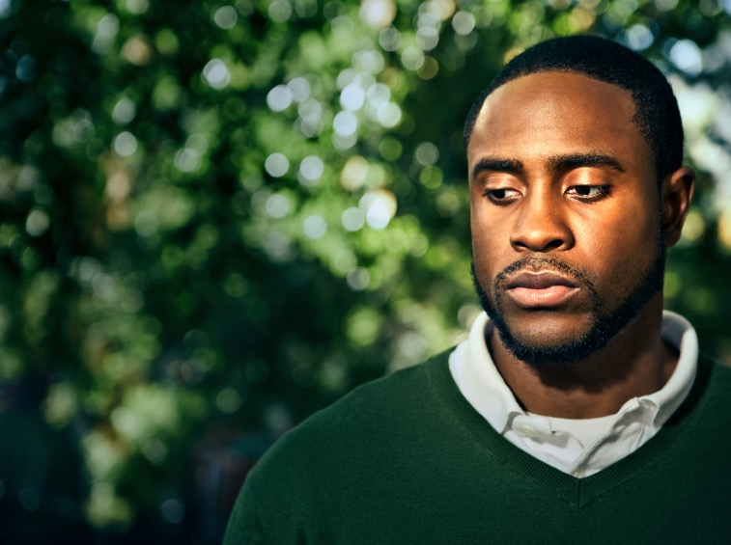
كيف يمكنك أن تساعد أولئك الذين يجتازون بأوقات صعبة ؟
Notes:
How can you help those who are going through tough times? What should you say to ease the pain rather than add to it like Job’s counselors? What do you do to help people in difficulty?

Slide 16
كيف يؤيدنا الله عندما نواجه أوقاتاً صعبة ؟
Notes:
Perhaps it’s even better to see how God affirms you and tells you how valuable you are to him? Do you see him affirming you?

Slide 17
خلفية 2 تسالونيكي
Notes:
Today we will look at a church caught in the “winepress of persecution” that had yielded to God, resulting in a fragrant display of God’s grace. The Thessalonians still had “persecutions and trials” about a year after Paul had established the church but they were bearing under it, though crushed.

Slide 18
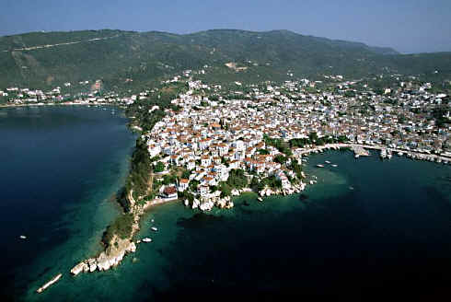
مدينة الميناء على الخليج الحراري
Notes:
The church was located in northern Greece on a peninsula as both a key port city…

Slide 19
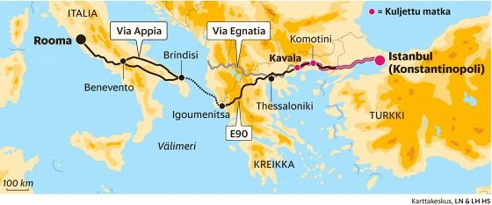
مدينة الميناء على الخليج الحراري
محبوك معا 26 قرية
الميناء الرئيسي والقاعدة البحرية لمقدونيا
Notes:
…and also on the main east-west land route in the Roman Empire called the Via Egnatia.

Slide 20
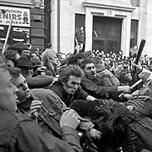
ارموه
في السجن
أوافق
مع بولس
ماذا نفعل ؟
Notes:
Paul established the Thessalonian church amidst great difficulty. The background is in Acts 17.

Slide 21
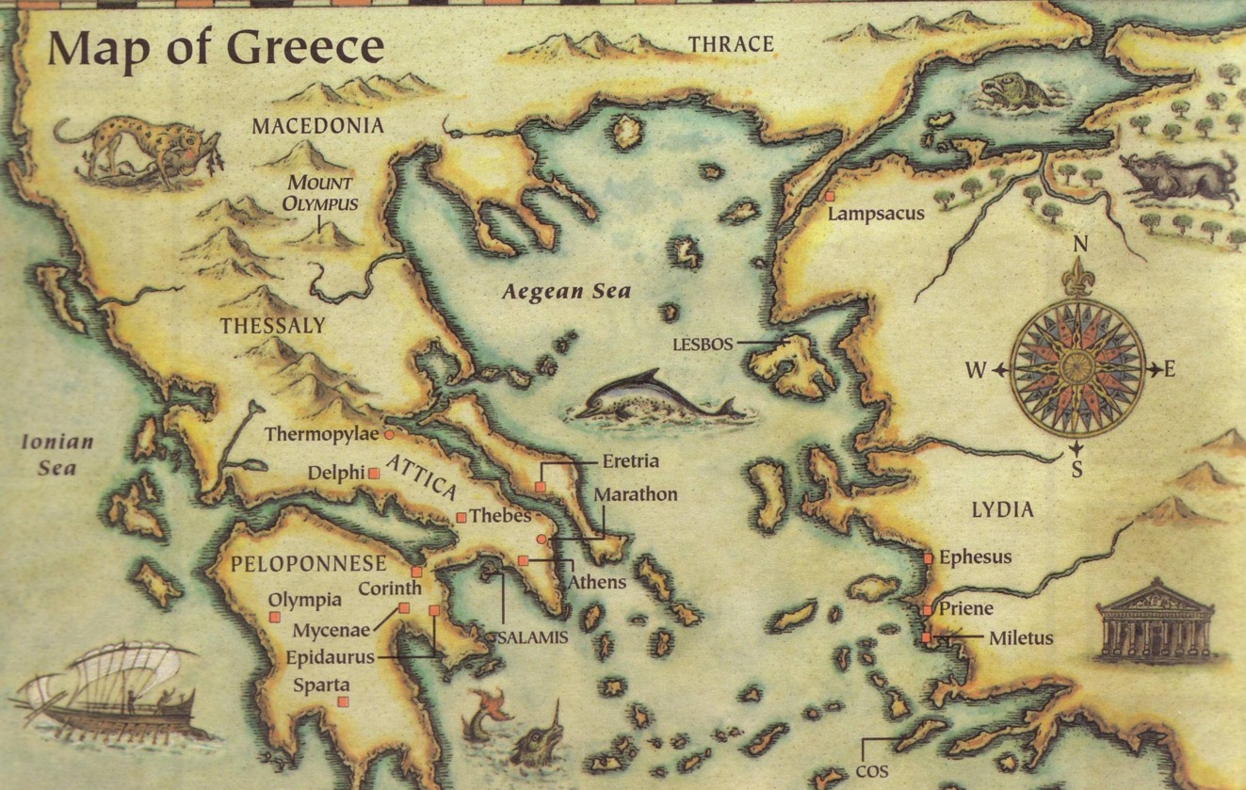
هذه الرسالة كتبت في 51 م
تسالونيكي
بيرية
اثينا
كورنثوس
نستطيع تشجيع الآخرين بثلاث طرق
كتبت في كورنثوس بعد سماع تقرير تيموثاوس
Notes:
Paul only stayed there about three months, but the Jews who kicked him out over to Berea even followed him to Berea and kicked him out of there too!

Slide 22
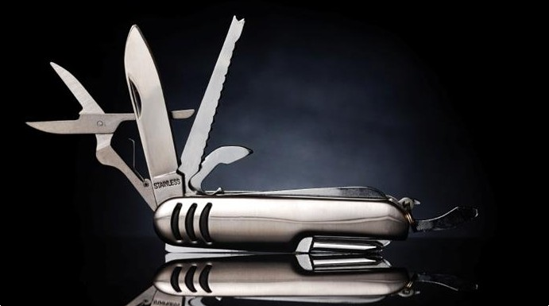
كن مستعداً
١ تسالونيكي
د. ريك جريفيث • مؤسسة الدراسات اللاهوتية الأردنية
BibleStudyDownloads.org

Slide 23
Our Need
1 تسالونيكي
Notes:
At some point in perhaps the not-too-distant future millions of people will just quickly rise to meet the Lord Jesus Christ.

Slide 24
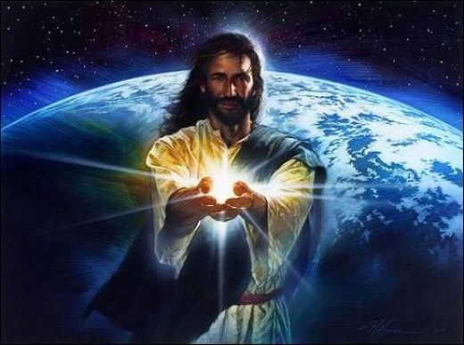
Black

Slide 25
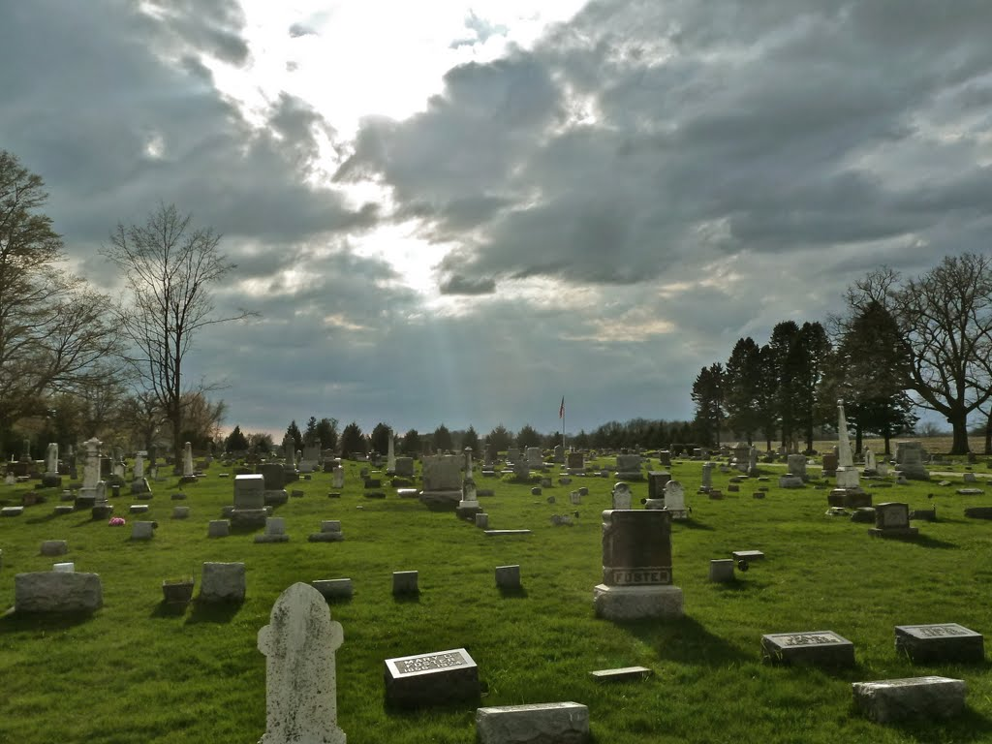
الإختطاف
ثم لا أريد أن تجهلوا أيها الإخوة من جهة الراقدين
لكي لا تحزنوا كالباقين الذين لا رجاء لهم
لأنه إن كنا نؤمن أن يسوع مات و قام
فكذلك الراقدون بيسوع سيحضرهم الله ايضاً معه
(1 تس 4: 13-14)
Notes:
Paul speaks clearly of this next event on God’s prophetic calendar in 1 Thess 4:13-18…

Slide 26
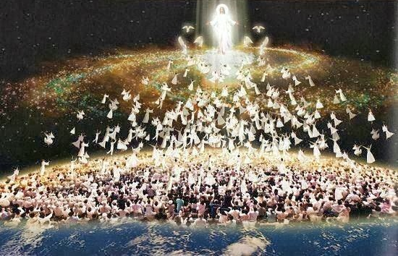
الإختطاف
لأن الرب نفسه بهتاف بصوت رئيس ملائكة و بوق الله
سوف ينزل من السماء و الأموات في المسيح سيقومون أولاً
ثم نحن الأحياء الباقين سنخطف جميعاً معهم في السحب
لملاقاة الرب في الهواء و هكذا نكون كل حين مع الرب
لذلك عزوا بعضكم بعضاً بهذا الكلام (1 تس 4: 16-18)

Slide 27
كيف يمكنك أن تكون مستعداً للإختطاف ؟
طريقتين
1 تسالونيكي
Notes:
What specific ways can you be ready for Jesus when he come back?

Slide 28
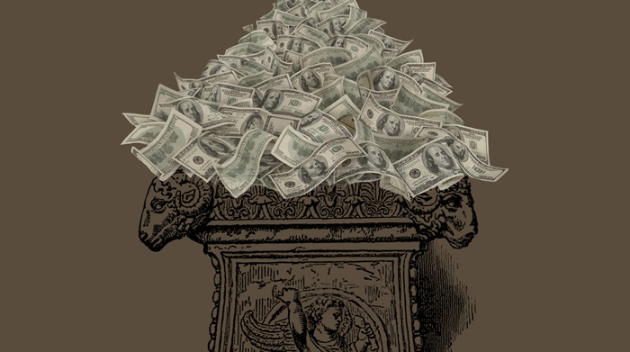
1. إخدم يسوع بدون طمع (الإصحاحات 1-3)
1 تسالونيكي
Notes:
Live for Christ as if money is not a big concern.

Slide 29
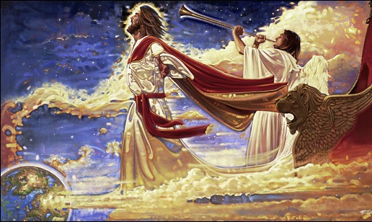
2. اهتم بكل من الناس و اللاهوت (الإصحاحات 4-5)
+
1 تسالونيكي
Notes:
Doctrine and relationships should occupy much of our time.
In particular, we need a theology of Christ’s second coming.

Slide 30
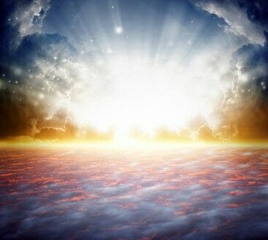
الفكرة الرئيسية
كن مستعداً لرجوع المسيح بمالك و أصدقائك و كتابك المقدس
1 تسالونيكي

Slide 31
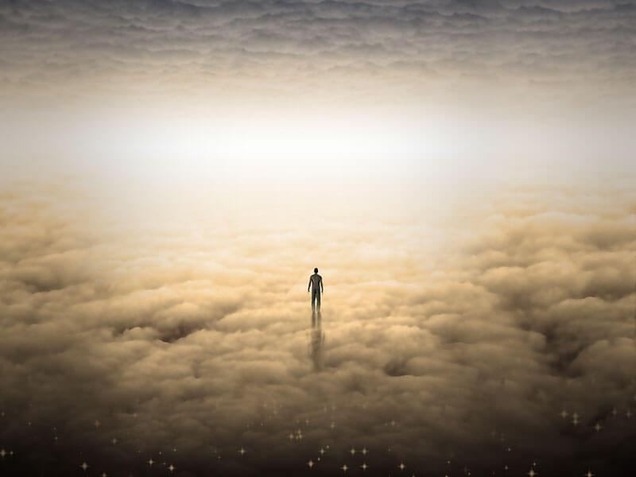
كلنا سنعطي حساباً
1 تسالونيكي

Slide 32
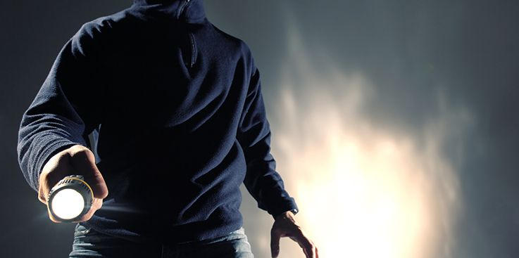
1 تسالونيكي 5: 2
كلص في الليل
Notes:
Do you think your home will be broken into tonight? At his return, Jesus will be as expected as much as you expect a thief to rob your house tonight.
Are you prepared for him to arrive at any time? Is there anything you do that will cause you to be ashamed if he came at that time you do it?

Slide 33
نظرة عامة على العهد الجديد (رسائل بولس)
143
38 124 39-41
إلى أقصى الأرض (أع 1: 8)
أع 9 13 14 15 16 18 21 27 28
أيلول 53- أيار 57
3 آسيا
نيسان 48-أيلول49
1 غلاطية
نيسان 50- أيلول 52
2 إيجة
شباط 60- آذار 62
1 رومية
أيلول 62- خريف 67
4 إسبانيا
خريف 67 - ربيع 68
2 رومية
صيف 35-37
أيار 57- آب 59
المحاكمات
خريف 49
المجمع
ربيع 68
اتساع
الكنيسة
35 48 49 50 52 53 57 60 62 67 68 95
متى
لوقا
أعمال
مرقس
يوحنا
غل
1 تس
2 تس
الأناجيل و الأعمال
4321
الرحلات
الرسائل البولسية
رومية
السجون
Pauline
Notes:
By the time Paul wrote Romans, he had seen the church planting movement reach the eastern part of the Empire! He notes this in Romans 15.

Slide 34
1-2 تسالونيكي
مكدونية
212
تسالونيكي
كورنثوس
Notes:
But now, months later, Jesus had not come and the church was wondering if they had already entered the tribulation. So Paul wrote them another letter to show how God continued to affirm them.

Slide 35
الحجة
214
كتب بولس 2 تسالونيكي ليساعد المؤمنين على تحمل ثلاث صعوبات تواجه الكنيسة:
1. الإضطهاد المتزايد (1: 3-10)
2. التعليم الكاذب أن يوم الرب قد حضر (2: 1-12) و
3. الكسل لدى بعض المؤمنين التسالونيكيين الكسالى الذين كانوا ينتظرون الإختطاف (3: 6-15)
كتب بولس حتى يشجع على الثبات المعتمد على مكافأتهم المستقبلية في يوم الرب (الإصحاح 1) و يصحح فكرتهم الخاطئة عن يوم الرب (الإصحاح 2) لذلك نصحهم بالإنضباط بدلاً من الكسل (الإصحاح 3)
الموضوع الرئيسي هو يوم الرب و آثاره على السلوك

Slide 36
كيف يؤيدنا الله عندما نواجه أوقاتاً صعبة ؟
3 طرق

Slide 37
2 تسالونيكي 1

Slide 38
ملخص ٢ تسالونيكي
كيف يؤيد الله ؟
المشاعر
١

Slide 39
1. عاطفياً : يعطي الله المثابرة لياتي بالنضوج (2 تس 1)
Notes:
The Lord helps us not to lose heart so we will grow.
Paul mentions his fellow-workers Silas and Timothy but not his position as an apostle to begin his letter relationally (1:1-2).

Slide 40
نصيحة بولس للتسالونيكيين المضطربين التركيز على الله التركيز على الله في رسائل تسالونيكي
215
Focus on God in the Thessalonian Epistles
محموع الأعداد | الله | يسوع | الرب | المسيح | المجموع
1 تس (89) | 36 | 16 | 24 | 10 | 86
2 تس (47) | 18 | 13 | 22 | 10 | 63
المجموع (136) | 54 | 29 | 46 | 20 | 149
عدد مرات ورود الكلمة اليونانية من إيويل و ياربروغ
المقابلة مع العهد الجديد، 332

Slide 41
الفكرة الرئيسية في متى
اخدم الرب يسوع المسيح
الله
الرب
الملك
يسوع
المسيح
المخلص
Notes:
Serve Jesus as Savior, God, and King of your life!
One core value of our church is to be context-relevant. We present the unchanging Lord Jesus Christ to our ever-changing world because no one is more relevant than him. How do we do this? We proclaim that he is the ultimate authority as God (Lord), yet took on humanity to save us from our sins (Jesus) and will rule over all (Christ).

Slide 42
اسم يستحق التكرار
2 تس 1
2 تس 2
2 تس 3
الرب يسوع المسيح (1: 1)
الرب يسوع المسيح (2: 1)
الرب يسوع المسيح (3: 6)
الرب يسوع المسيح (1: 2)
الرب يسوع المسيح (2: 14)
الرب يسوع المسيح (3: 12)
الرب يسوع المسيح (1: 12)
الرب يسوع المسيح (2: 16)
الرب يسوع المسيح (3: 18)
Notes:
The lofty name of the “Lord Jesus Christ” appears 9 times in this book—three times each in all three chapters (NLT):
2Th. 1:1 This letter is from Paul, Silas, and Timothy. We are writing to the church in Thessalonica, to you who belong to God our Father and the Lord Jesus Christ.
2Th. 1:2 May God our Father and the Lord Jesus Christ give you grace and peace.
2Th. 1:12 Then the name of our Lord Jesus will be honored because of the way you live, and you will be honored along with him. This is all made possible because of the grace of our God and Lord, Jesus Christ.
2Th. 2:1 Now, dear brothers and sisters, let us clarify some things about the coming of our Lord Jesus Christ and how we will be gathered to meet him.
2Th. 2:14 He called you to salvation when we told you the Good News; now you can share in the glory of our Lord Jesus Christ.
2Th. 2:16 Now may our Lord Jesus Christ himself and God our Father, who loved us and by his grace gave us eternal comfort and a wonderful hope,
2Th. 3:6 And now, dear brothers and sisters, we give you this command in the name of our Lord Jesus Christ: Stay away from all believers who live idle lives and don’t follow the tradition they received from us.
2Th. 3:12 We command such people and urge them in the name of the Lord Jesus Christ to settle down and work to earn their own living.
2Th. 3:18 May the grace of our Lord Jesus Christ be with you all.

Slide 43
شاهد وجهة نظر الله في التجارب (1: 1-2)
Notes:
So these first two verses show that seeing God's perspective helps us to reach out and affirm others. There’s another way to affirm others in verse 3…

Slide 44
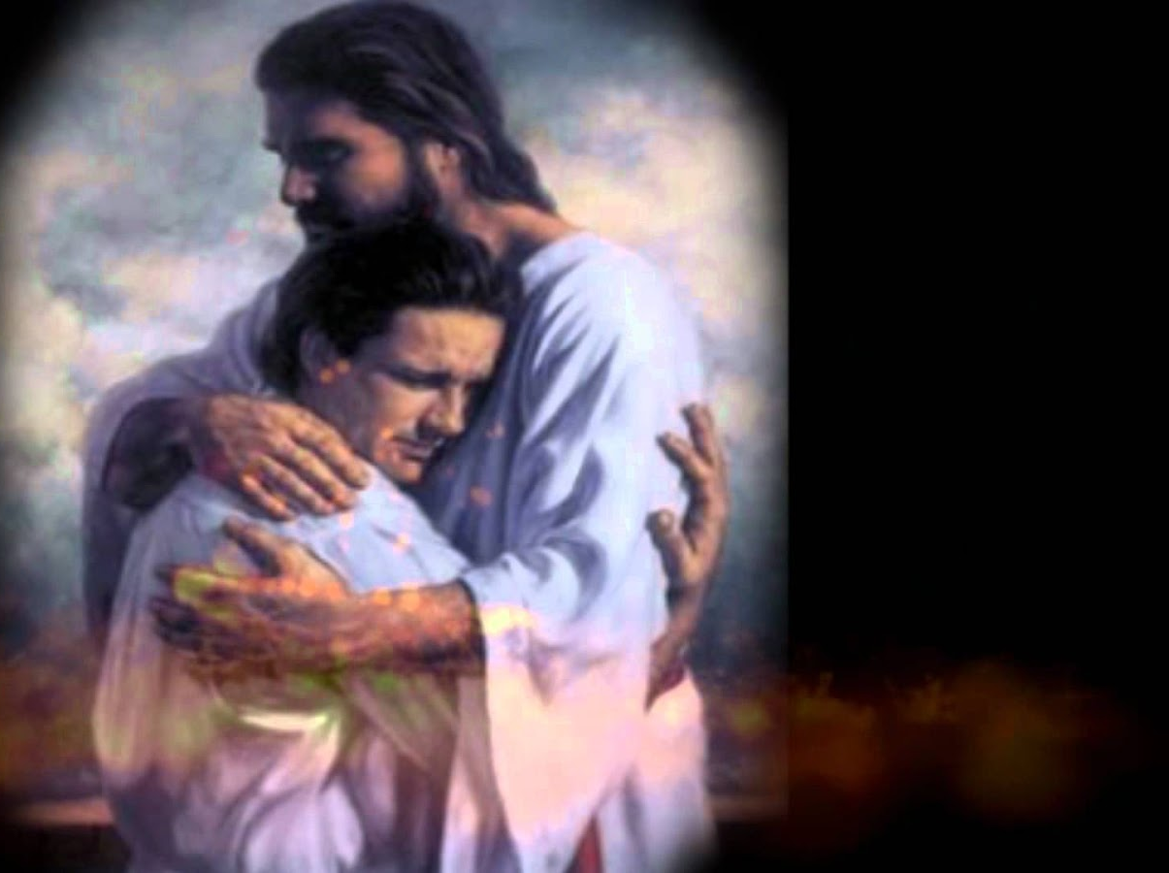
بولس و سلوانس و تيموثاوس إلى كنيسة التسالونيكيين في الله أبينا و الرب يسوع المسيح نعمة لكم و سلام من الله أبينا و الرب يسوع المسيح
2 تسالونيكي 1: 1-2
Notes:
You may be wondering why I say that these verses teach us to help afflicted people see God's perspective. Aren't they just the preliminaries to the letter that follows?
Yes, but notice how many times Paul mentions God in this one sentence—four times!
Twice he refers to the Father and twice to Christ, who is placed on equal level with the Father since He, too, is God.

Slide 45
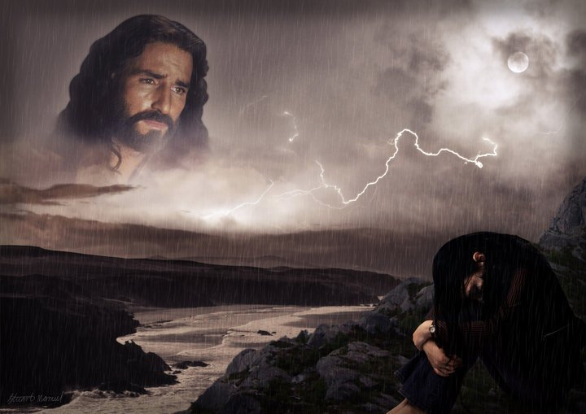
من خلال النظر إلى ربنا السامي يسوع المسيح ندرك أنه لا ينظر بعيداً عنا في رضا عن النفس لكنه ينظر إلينا بتحنن
تشارلز ر. سويندول، المسيحية الصامدة، 4
Notes:
We all have peaks and valleys in our lives—peaks when it's easy to see the Lord and valleys when it's difficult to see Him. Swindoll writes…
• Text above

Slide 46
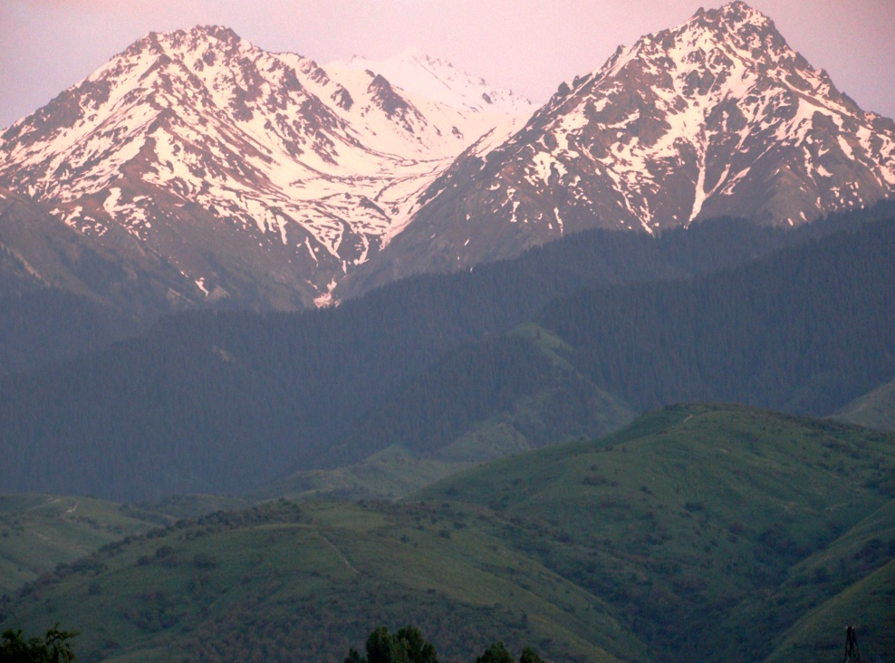
أرفع عيني إلى الجبال من حيث يأتي عوني معونتي من عند الرب صانع السماوات و الأرض (مز 121: 1-2)
تشارلز ر. سويندول، المسيحية الصامدة، 4

Slide 47
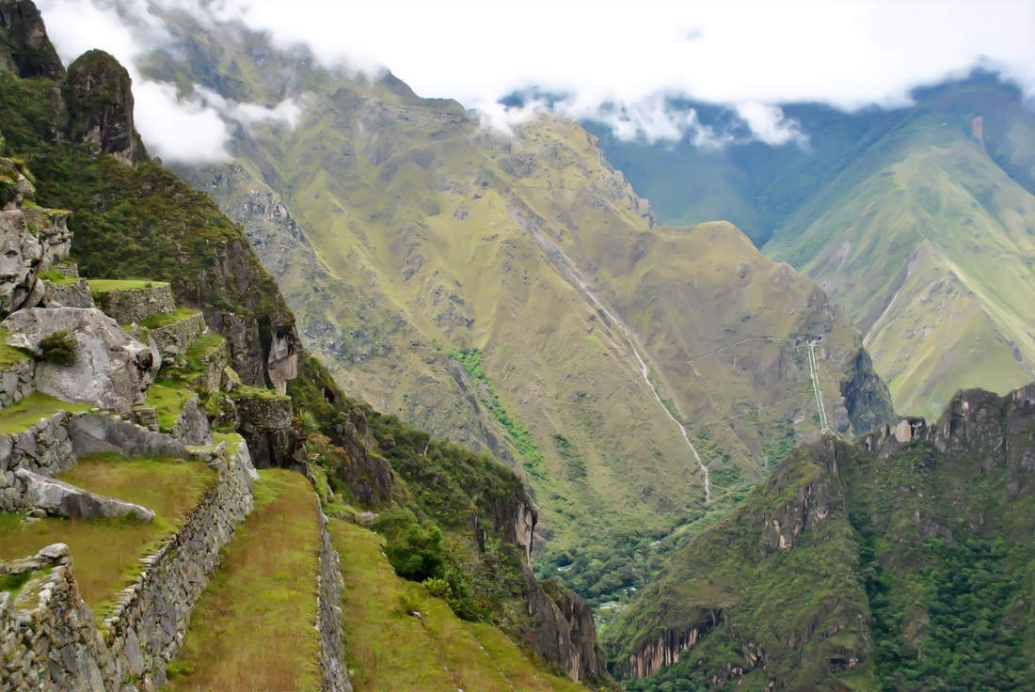
هل تنظر إلى القمم عندما تكون في الوديان؟ أم أنك ممتلئ بالوديان لدرجة أنك نسيت أن الجبال موجودة هناك؟ الأشخاص الذين يفشلون في التأكيد يفعلون ذلك عادة لأنهم يفشلون في رؤية الرب في وسط كل هذا
تشارلز ر. سويندول، المسيحية الصامدة، 4

Slide 48
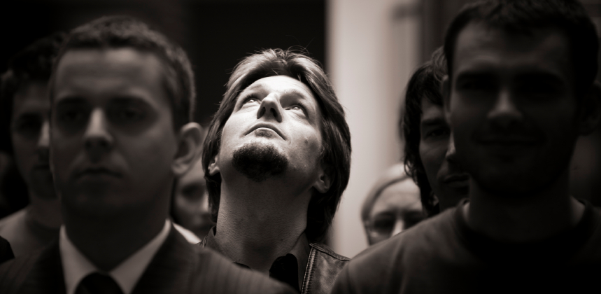
ندما ننظر إلى الأعلى ، نتذكر أن الله لا يزال موجوداً ... هو ليس غائبًا ... وليس بعيدًا عن متناول اليد. وبعد ذلك نحصل على لمحة عن المنظور الإلهي لظروفنا - والذي لا يمكن رؤيته إلا من القمم ، وليس في الوديان
تشارلز ر. سويندول، المسيحية الصامدة، 4

Slide 49
SEEING LIFE FROM GOD'S PERSPECTIVE
Your life's experiences can be different when viewed from God's perspective.
Notes:
Aren't you encouraged when you're around people who always talk about the Lord?
They see life from God's viewpoint—and there's no more encouraging view!

Slide 50
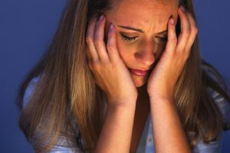
نحتاج أيضاً لمساعدة الآخرين أن يركزوا على الرب وسط صعوباتهم

Slide 51
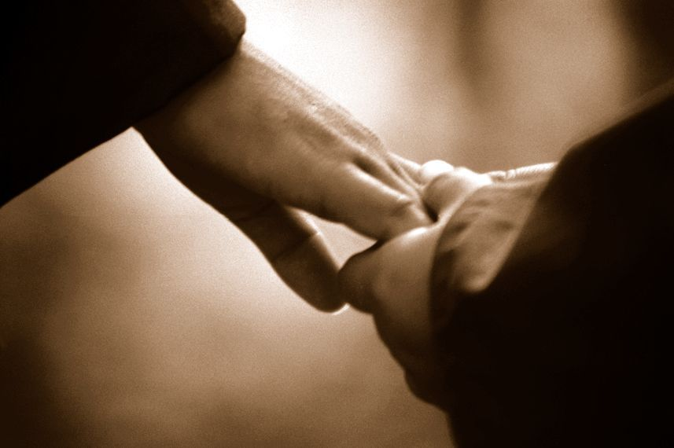
حول الآخرين إلى الرب
بعدم قول أي شيء
بمشاركة مرجع كتابي
Notes:
There are ways of turning people's sights to the Lord without always quoting Scripture and saying, "Praise Jesus, Praise Jesus…"
• Sometimes we affirm and turn others to God by saying nothing at all.
• Often just writing down a Scripture reference for the person and encouraging him to look it up later is best.

Slide 52
أشكر الله من أجل نمو الآخرين (1: 3)
Notes:
Others benefit in their spiritual walk when they hear you praise God for them.

Slide 53
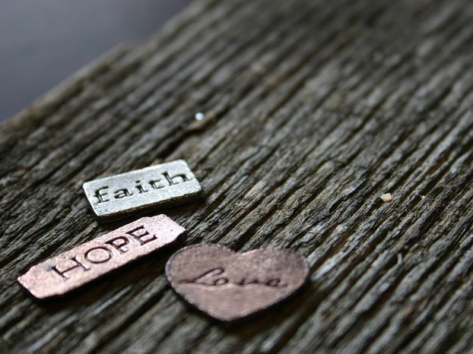
ينبغي لنا أن نشكر الله كل حين من جهتكم أيها الإخوة كما يحق لأن إيمانكم ينمو كثيراً و محبة كل واحد منكم جميعاً بعضكم لبعض تزداد (2 تسالونيكي 1: 3)
Notes:
Paul thanked God for two things—their faith and their love (1:3).
I wonder how often you thank God for others’ spiritual growth. When someone is going through trials how do we generally pray?
I hate to admit it, but most of the time we ask God to remove the trials.
Notice the focus of Paul's prayer here—not a request that God take away their trials but thanksgiving!
He affirmed them by praying not for the removal of the trial but for character development through the trial.
Paul doesn't focus on what's going on around them—he looks at what God is doing within them—building qualities like faith, love, and perseverance mentioned in verse 4.

Slide 54
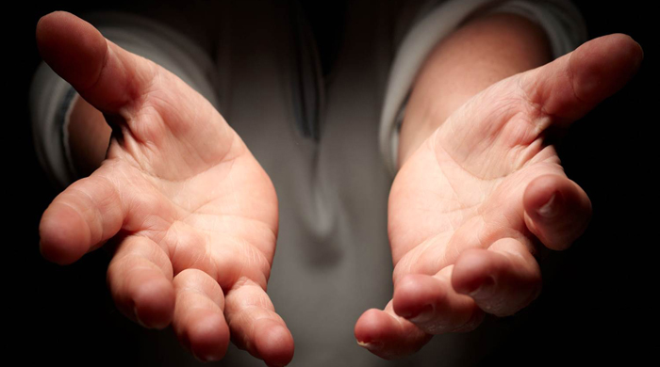
أكد لهم أن محبتهم لبعضهم البعض استمرت في الإزدياد لذلك نرى بولس يؤكد على تأكيدهم

Slide 55
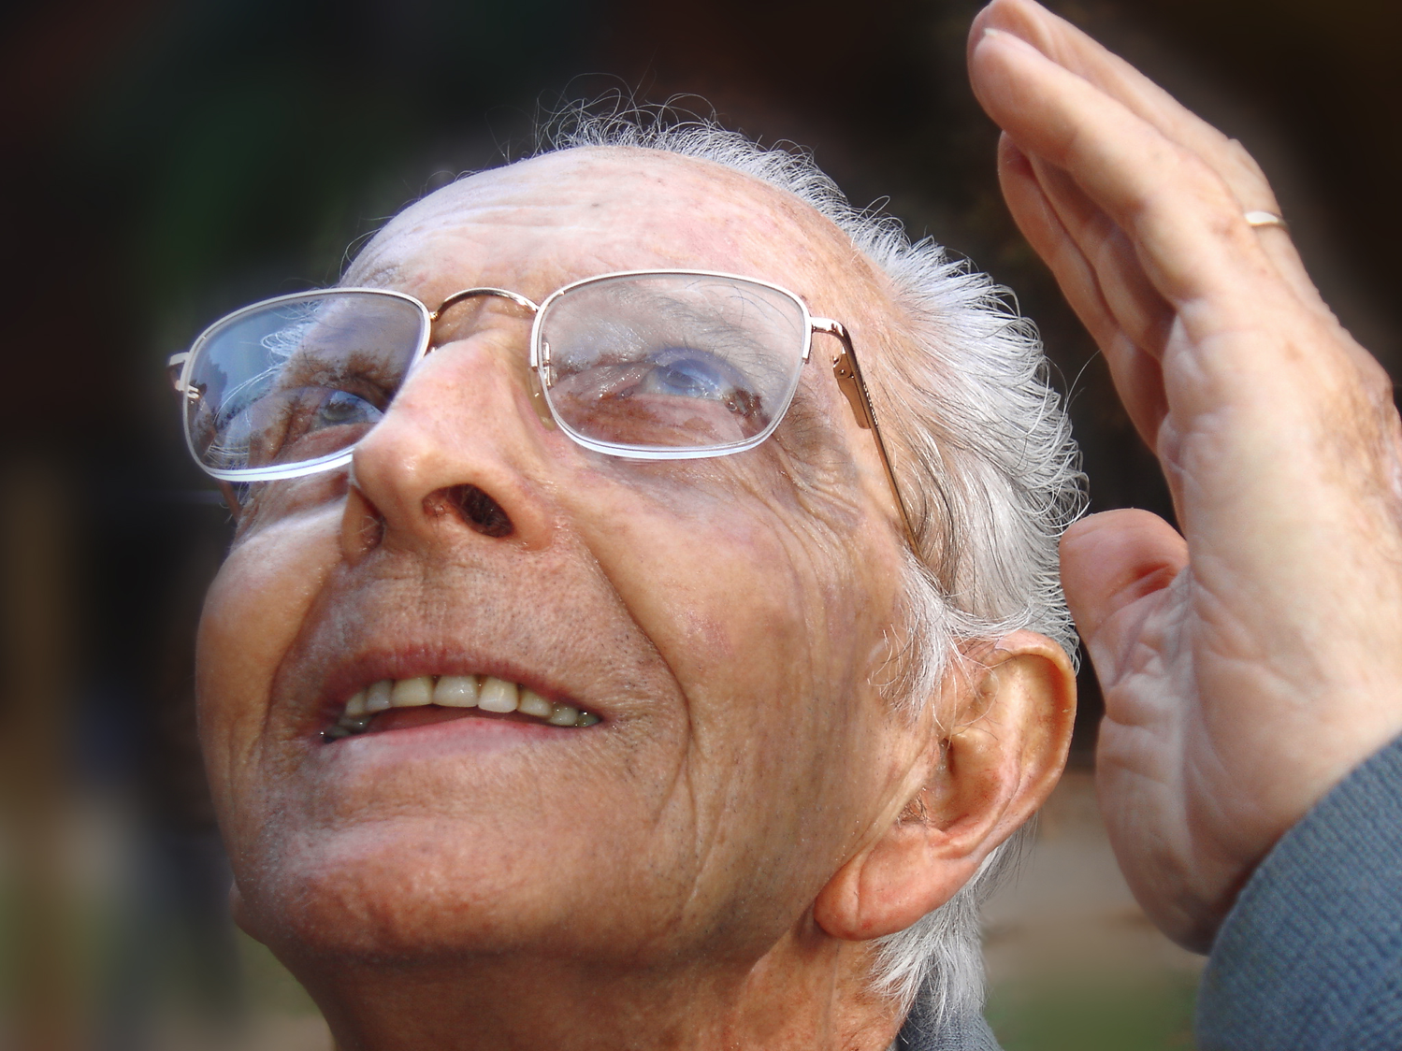
تأكيدات الصلاة
Notes:
Prayer for others is no doubt the best way to affirm others. That's why Paul did it!
I hope as a church we’ll grow to pray beyond a focus on the circumstances and pray that God will use difficulties to build the character of Christ within us.
The three qualities Paul notes are a great starting place—faith, love and perseverance.
MPI
I think our prayer times together as a church would be even better if we make it a point to thank God for others' growth right there in the group.

Slide 56
افتخر علانية بالنمو الروحي للآخرين (1: 4)
Notes:
Make your praise common knowledge to help others persevere.

Slide 57
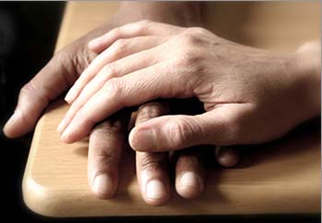
حتى إننا نحن أنفسنا نفتخر بكم في كنائس الله من أجل صبركم و إيمانكم في جميع اضطهاداتكم و الضيقات التي تحتملونها
2 تسالونيكي 1: 4
Notes:
Paul told others how well they hung in there (1:4).
He could have been negative—“Man, you should see those Thessalonians’ hassles. Their theology is messed up so much they think they’re in the Tribulation!”
Not Paul! He said, "Wow! You should see how the church at Thessalonica continues to reach out, deepen in their love, make great strides in trusting God, and endure—despite the most intense persecutions in the Roman Empire. They're doing grrrrrrrreat!"

Slide 58
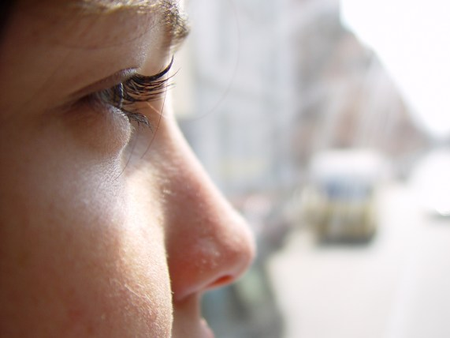
عادة ما يصبح الناس ما تخبرهم أنهم سيصيرونه
Notes:
People often become what you tell them they will become.
This is especially true in parenting children.
The important principle here is that people will become what you tell them they will become. This is especially true in parenting children.

Slide 59
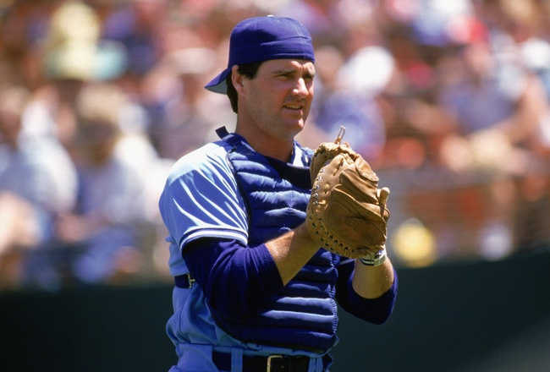
جين سانبيرغ
Notes:
Children tend to become what their parents tell them they will become. Major league baseball catcher Jim Sundberg said that his father was always telling Jim, “Jim, one day you’re going to be a great major league catcher.”

Slide 60
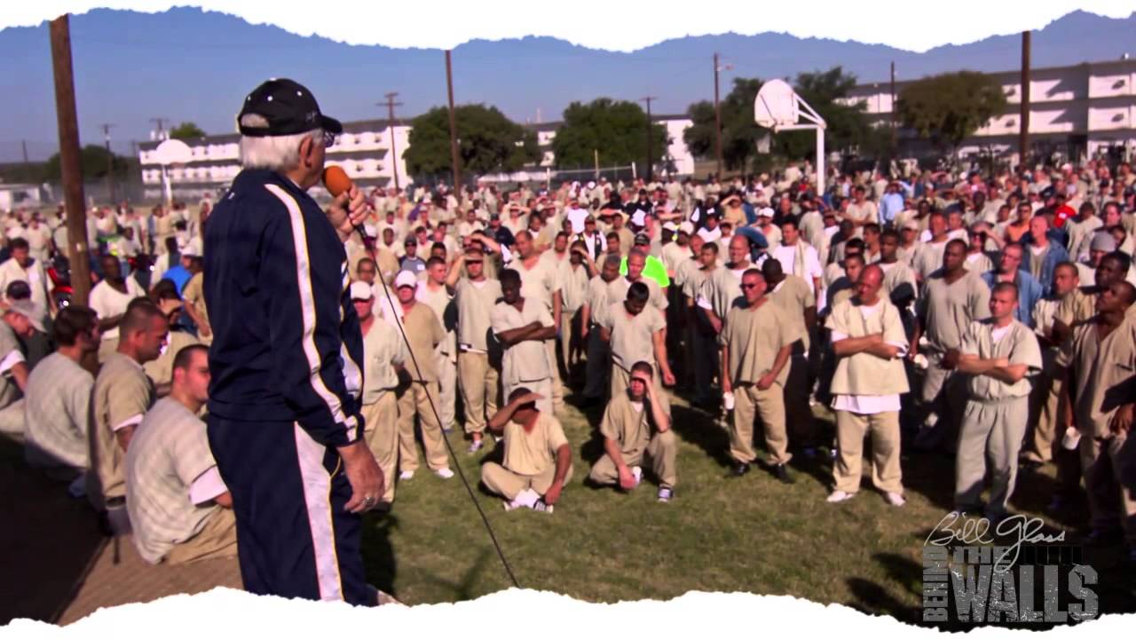
كم منكم لديه آباء أخبروك أنه سينتهي بك المطاف في السجن يومًا ما؟
Notes:
Evangelist Bill Glass asked a group of 1000 inmates, “How many of you had parents that told you that you would end up in prison one day?” Almost every one of the inmates raised their hands.

Slide 61
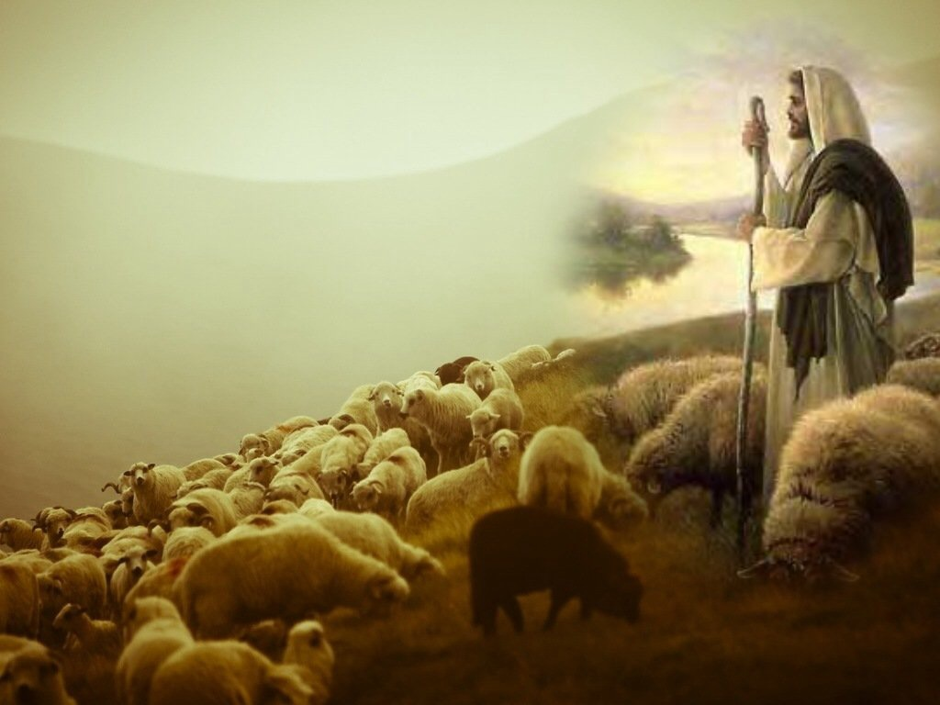
أيّد المتألمين لمساعدتهم على أن ينضجوا في المسيح
الفكرة الرئيسية في 2 تس 1: 1-4
Notes:
Encourge others to grow!

Slide 62
5 بينة على قضاء الله العادل أنكم تؤهلون لملكوت الله الذي لأجله تتألمون أيضاً 6 إذ هو عادل عند الله أن الذين يضايقونكم يجازيهم ضيقاً (2 تس 1: 5-6)
Notes:
God will reward the church’s perseverance during affliction but punish their persecutors by helping the church become mature (1:3-12).

Slide 63
7 و إياكم الذين تتضايقون راحة معنا عند استعلان الرب يسوع من السماء مع ملائكة قوته 8 في نار لهيب معطياً نقمة للذين لا يعرفون الله و الذين لا يطيعون إنجيل ربنا يسوع المسيح (2 تس 1: 7-8)

Slide 64
9 الذين سيعاقبون بهلاك أبدي من وجه الرب و من مجد قوته 10 متى جاء ليتمجد في قديسيه و يتعجب منه في جميع المؤمنين لأن شهادتنا عندكم صدقت في ذلك اليوم (2 تس 1: 9-10)

Slide 65
الأمر الذي لأجله نصلي أيضاً كل حين من جهتكم أن يؤهلكم إلهنا للدعوة و يكمل كل مسرة الصلاح و عمل الإيمان بقوة
2 تس 1: 11

Slide 66
لكي يتمجد اسم ربنا يسوع المسيح فيكم و أنتم فيه بنعمة إلهنا و الرب يسوع المسيح
2 تس 1: 12

Slide 67
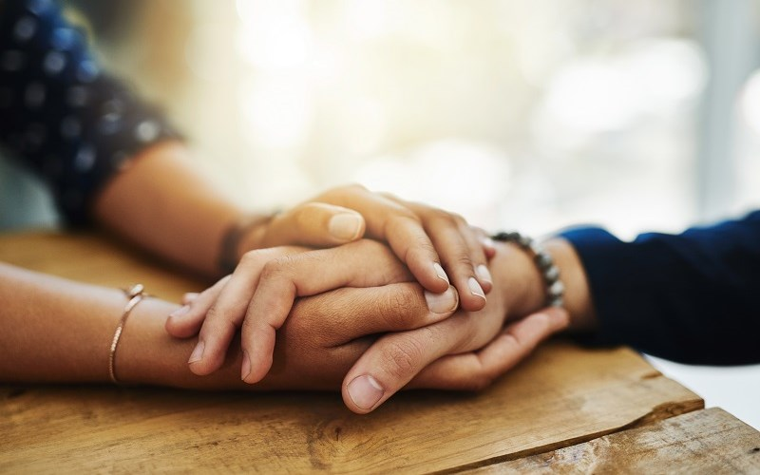
المثابرة خلال المصائب تنمي النضج
تشارلز ر. سويندول، المسيحية الصامدة، 3

Slide 68
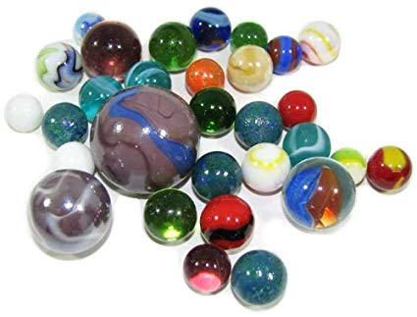
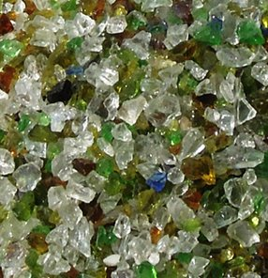
القلول أم العنب ؟
Notes:
We decide how difficulties will change us. Do you agree? In his book No Greater Power, Richard C. Halverson, past chaplain of the US Senate, wrote:
“Crush marbles and you get fragmentation, disintegration—hard, sharp pieces. You can get hurt if you’re not careful.
Crush grapes and you get fragrant, refreshing wine.
Some people relate like marbles. The fear of vulnerability hardens them. They protect themselves, allow no one to penetrate. Being vulnerable is high-risk, and they want low-risk. They bump against others and ricochet around, never enjoying a vital relationship. In brittle lovelessness, they shatter when crushed, and hurt others.
Some people relate like grapes. They yield to pressure. They accept their weakness as essential to intimacy. They give love, knowing love is always vulnerable, knowing love is the heart and soul of our faith. When crushed, they bring blessing: fragrant, redemptive blessing.”
Difficulties certainly come our way for every one of us.
But how do you respond to these trials? Are you like a marble or like a grape? In either case, we get crushed, but marbles resist it while grapes welcome the benefits.
Are you angry at God for allowing difficulty into your life? Or do you see him affirming you?
Richard C. Halverson, No Greater Power (Portland, OR: Multnomah, 1986), 67; cited in Charles R. Swindoll, Steadfast Christianity: A Study of Second Thessalonians (Fullerton, CA: Insight for Living, 1986), 1.

Slide 69
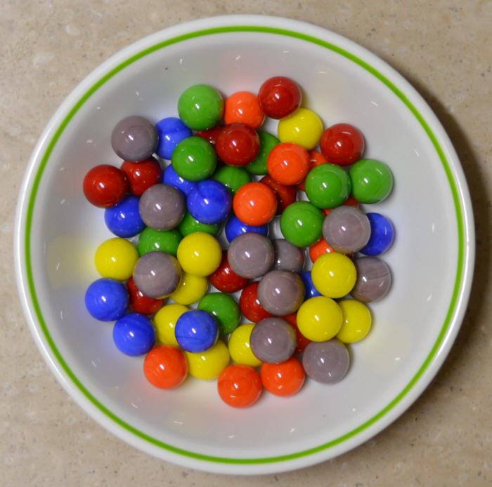
دفاعي
Notes:
I have needed affirmation to overcome my own weakness of defensiveness.
As I have recently reflected on my early years as a Christian teenager, I recall one particular weakness. When someone expressed a concern about me, I reacted with defensiveness. This was a problem I had in my early years of marriage too. Susan would observe a weakness in me and I would defend myself as if she was attacking me.
After further consideration and prayer about this, I realized that it went back to my teenage years. My mother married a third time when I was age 13, and my step-father would point out a deficiency in me rather roughly. He had a horrible relationship with his own father—so much that he called him by his first name rather than “Dad” or “Father”—and he lacked an ability to gently tell me how to better sweep the floor or wash the dishes or whatever. I constantly felt attacked, even though that wasn’t his intention.
So I developed this defensive attitude in my other relationships too. I suspect I felt that way about God as well.
God really changed me, though. At least I think he did! I guess you can be the judge whether I defend myself right now. I think he has given me an ability to respond rather than react, to persevere in a way that helps me grow in maturity.

Slide 70
كيف يؤيدنا الله عندما نواجه أوقاتاً صعبة ؟

Slide 71
1. عاطفياً : يعطي الله المثابرة لياتي بالنضوج (2 تس 1)
Notes:
The Lord helps us not to lose heart so we will grow.]

Slide 72
2 تسالونيكي 2

Slide 73
ملخص ٢ تسالونيكي
كيف يؤيد الله
مشاعر
١
لاهوت
٢
Notes:
II. Theologically: God gives us truth to bring stability (2 Thess 2).
[Theology matters! The Lord corrects our misconceptions to give us firm footing.]

Slide 74
2. لاهوتياً : يعطينا الله الحق ليأتي بالإستقرار (2 تس 2)
Notes:
Theology matters! The Lord corrects our misconceptions to give us firm footing.

Slide 75
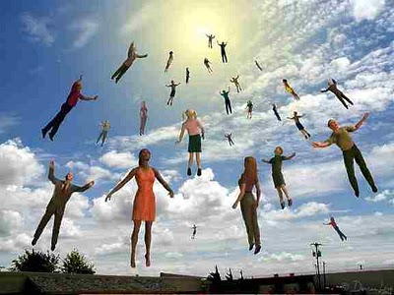
ثم نسألكم أيها الإخوة من جهة مجيء ربنا يسوع المسيح و اجتماعنا إليه (2 تس 2: 1)

Slide 76
الآية المفتاحية
211
أَنْ لاَ تَتَزَعْزَعُوا سَرِيعاً عَنْ ذِهْنِكُمْ، وَلاَ تَرْتَاعُوا، لاَ بِرُوحٍ وَلاَ بِكَلِمَةٍ وَلاَ بِرِسَالَةٍ كَأَنَّهَا مِنَّا: أَيْ أَنَّ يَوْمَ الْمَسِيحِ قَدْ حَضَرَ. ٣ لاَ يَخْدَعَنَّكُمْ أَحَدٌ عَلَى طَرِيقَةٍ مَا، لأَنَّهُ لاَ يَأْتِي إِنْ لَمْ يَأْتِ الاِرْتِدَادُ أَوَّلاً، وَيُسْتَعْلَنَ إِنْسَانُ الْخَطِيَّةِ، ابْنُ الْهَلاَكِ، )2: 2(3-
2 تسالونيكي

Slide 77
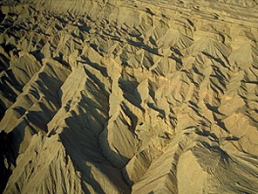
الدينونة
216
متبوعة ب ...

Slide 78
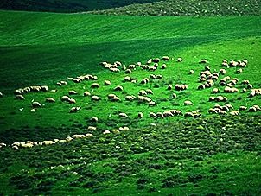
بركة
216

Slide 79
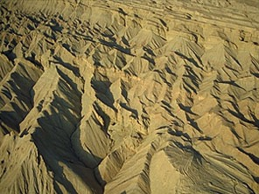
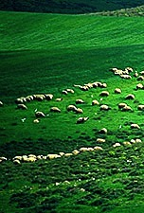
يوم الرب
216
دينونة
+
بركة
ضيقة
ألفية
رؤ 6-19
رؤ 20
7 سنوات
1000 سنة

Slide 80
الخط الزمني التدبيري
437
العرش
العظيم
الأبيض
(رؤ 20: 11-14)
الإختطاف (1 تس 4: 13-18)
المجيء الثاني
(زك 14: 3-5)
يوم الرب
عصر الكنيسة
الضيقة
(1 تس 5)
الألفية
(زك 14: 6-21)
Notes:
80
But the situation at Thessalonica still didn’t change—so much so that many in the church thought they were in the Great Tribulation. The persecution hadn't let up so he wrote them to affirm them for their steadfastness.

Slide 81
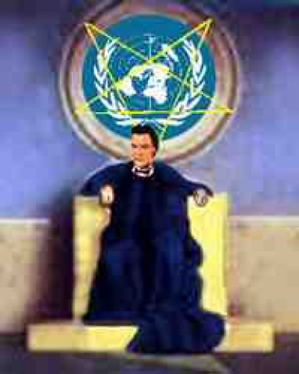
ضد المسيح يقيم صورة للعبادة (2 تس 2 : 3-4)
80ي
3 لا يخدعنكم أحد على طريقة ما لأنه لا يأت إن لم يأتي الإرتداد أولاً و يستعلن إنسان الخطية ابن الهلاك 4 المقاوم و المرتفع على كل ما يدعى إلهاً أو معبوداً حتى إنه يجلس في هيكل الله كإله مظهراً نفسه أنه إله

Slide 82
لأنه لا يأتي إن لم يأت (2: 3أ)
213
1. التمرد (الإرتداد) يحدث (3ب)
= العالم المسيحي مرتد تماماً
2. يستعلن إنسان الخطية (3ت)
= ضد المسيح يبرم معاهدة مع إسرائيل (دا 9: 27)
3. إلى أن يرفع من الوسط الذي يحجز الآن (7ب)
= تأثير الحاجز بالروح القدس في الكنيسة سوف يرفع إلى السماء

Slide 83
أما تذكرون و اني أنا بعد عندكم كنت أقول لكم هذا و الآن تعلمون ما يحجز حتى يستعلن في وقته لأن سر الإثم الآن يعمل فقط إلى أن يرفع من الوسط الذي يحجز الآن و حينئذ سيستعلن الأثيم الذي الرب يبيده بنفخة فمه و يبطله بظهور مجيئه (2 تس 2 : 5-8)

Slide 84
الحاجز
209
الروح الحاجز للشر من خلال الكنيسة سوف يكون غائباً :(2 تس 2: 6-7)
و الآن تعلمون ما يحجز حتى يستعلن في وقته
لأن سر الإثم الآن يعمل فقط
إلى أن يرفع من الوسط الذي يحجز الآن
( ما يحجز = محايد، 2: 6 = الكرازة بالإنجيل(
( الذي يحجز = مذكر، 2: 7 = شخص)
( روح = اسم محايد لكن مستخدم لشخص)

Slide 85
يوم الرب
2 تس 2: 3-7 هي متطلب سابق قبل يوم الرب (3 منهم) :
213
1
كرسي الدينونة في السماء
2 كو 5: 10، 1 كو 3: 10-15
3 الحاجز (2: 7ب)
2
1 الإرتداد (2: 3ب)
2 ضد المسيح (2: 3ت)
3
1
المجيء الثاني رؤ 19: 11-21
الإختطاف 1 تس 4 : 13-18
الضيقة
الألفية
الحالة الأبدية
3
1000 سنة
69 أسبوع (دا 9: 24-27)
عصر الكنيسة مت 16: 18 أع 2: 1-4
2
5ر3
5ر3
رؤ 20: 4-6
(غير محدودة)
7 سنوات
(أسبوع دانيال السبعين) مت 24: 21
مت 27: 50
فترة تحضيرية بسيطة
قيام ضد المسيح (طول الفترة غير معروف)
النبوة ( سلسلة فيديوهات كلية دالاس، 1980)

Slide 86
9 الذي مجيئه بعمل الشيطان بكل قوة و بآيات و عجائب كاذبة 10 و بكل خديعة الإثم في الهالكين لأنهم لم يقبلوا محبة الحق حتى يخلصوا 11 و لأجل هذا سيرسل إليهم الله عمل الضلال حتى يصدقوا الكذب 12 لكي يدان جميع الذين لم يصدقوا الحق بل سروا بالإثم (2 تس 2 : 9-12)

Slide 87
فراغ قيادة ضخم
216أ
الأوقات الصعبة هي التي تهيئ المسرح دائمًا للديكتاتوريين للإرتقاء إلى مستوى المناسبة.

Slide 88
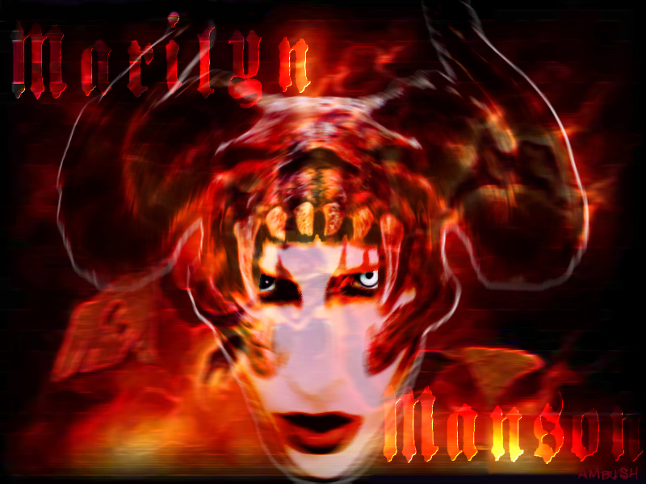
أسماء ضد المسيح
216أ
79
رجل الدماء و الغش (مز 5: 6
القرن الصغير (دا 7: 8)
إنسان الخطية (2 تس 2: 3)
الوحش الطالع من البحر (رؤ 13: 1)
المخرب (دا 9: 27)

Slide 89
نشاط ضد المسيح
216أ
79

Slide 90
التسلسل الزمني للأسبوع السبعين
333
مقتبسة من ج. دوايت بنتيكوست، كلية دالاس اللاهوتية، 1988
منتصف الأسبوع
علامة ابن الإنسان
مت 24: 30
اكتمال رجوع المسيح
3 سنوات و نصف
1290 يوم
دا 12: 11
30 يوم
30 يوم
1260 يوم
45 يوم
رؤ 11: 3، 12: 6
دا 12: 12
3 سنوات و نصف
3 سنوات و نصف
تعيين الوحش رؤ 17: 13
قطع العهد دا 9: 27أ
Covenant Broken Dan. 9:27b
المجيء الثاني
الضيقة العظيمة
الضيقة

Slide 91
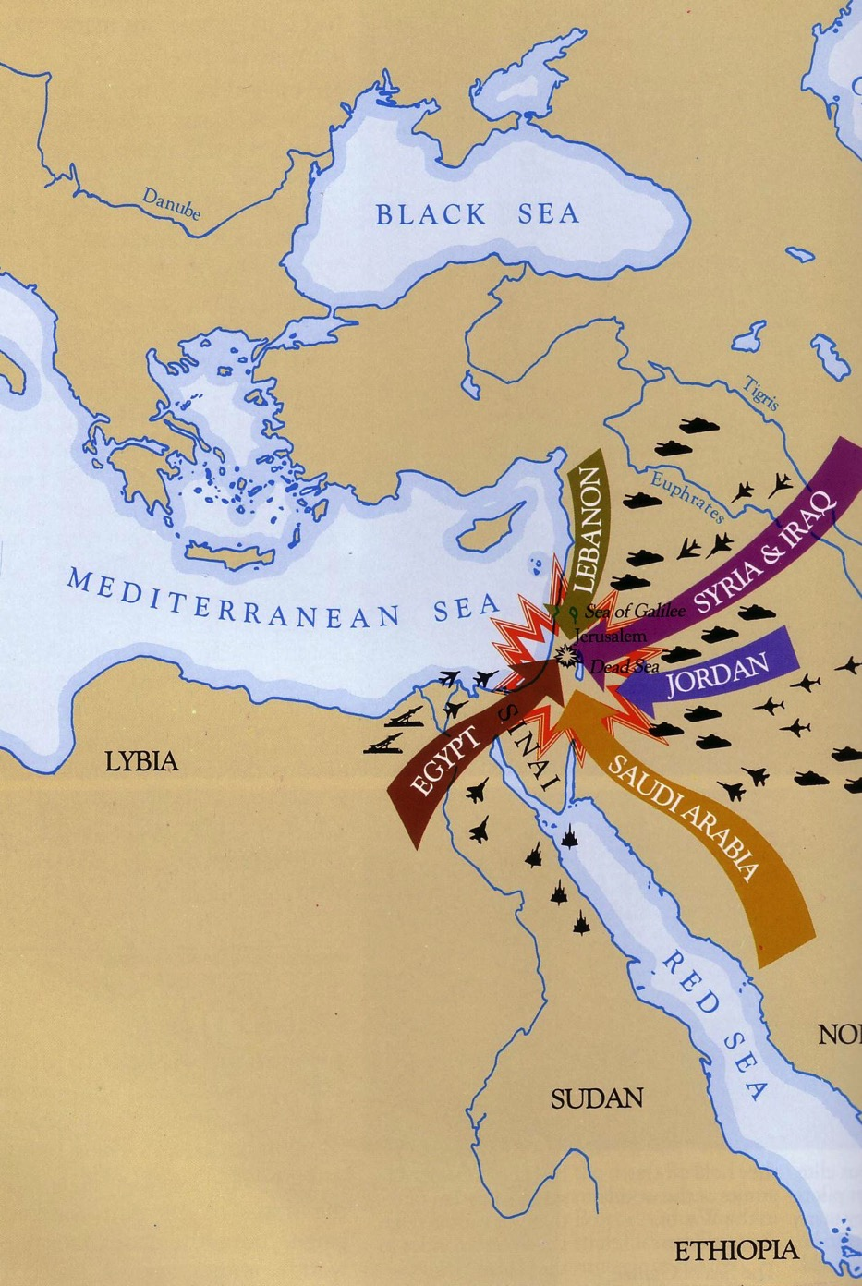
دانيال 11: 40
543
أعداء إسرائيل سيغزون أرضها

Slide 92
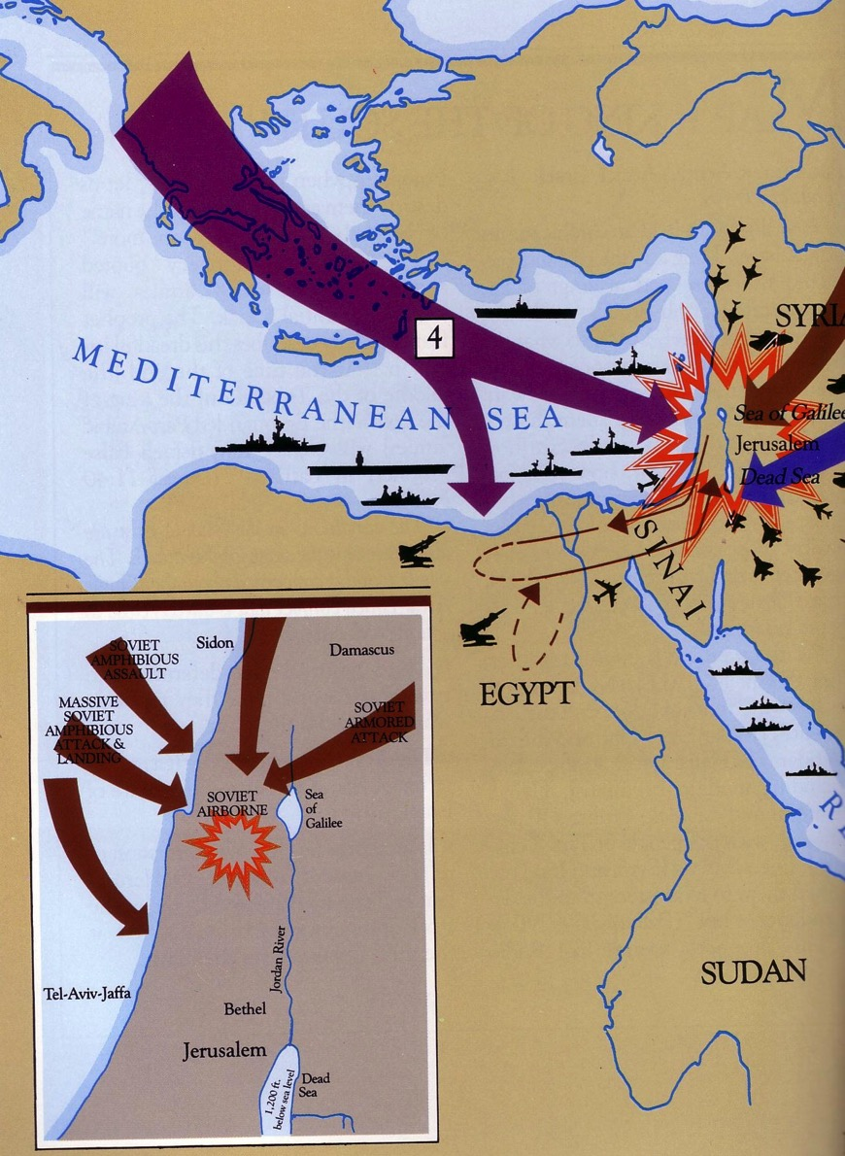
دانيال 11: 40-45
حتى السفن في البحر الأبيض المتوسط سينضمون إلى المعركة

Slide 93
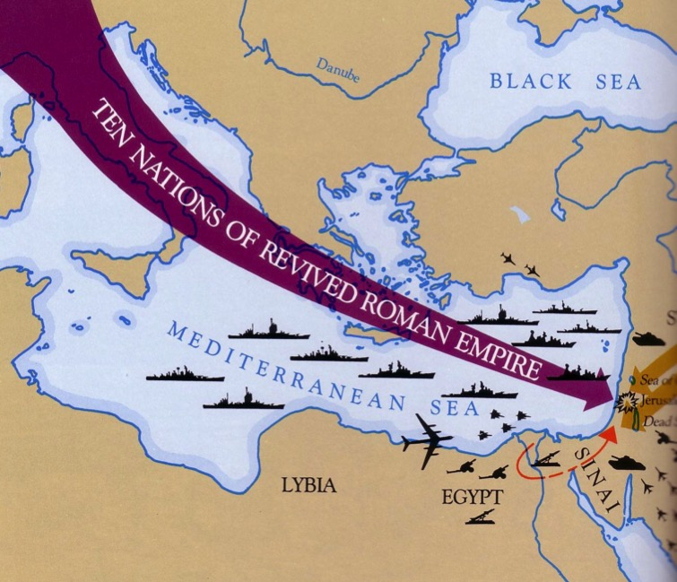
الغرب يلتقي بالشرق (دا 11: 44)

Slide 94
الوحوش في رؤيا 13
387
التنين = الشيطان
وحش الأرض =
النبي الكذاب
وحش البحر =
ضد المسيح
Used with permission

Slide 95
الثالوث الشيطاني
387
الآب =
الشيطان
الإبن =
ضد المسيح
الروح =
النبي الكذاب

Slide 96
العالم سيعبد الوحش

Slide 97
السمة في اليد اليمنى
و يجعل الجميع الصغار و الكبار و الأغنياء و الفقراء و الأحرار و العبيد تصنع لهم سمة على يدهم اليمنى أو على جبهتهم و أن لا يقدر أحد أن يشتري أو يبيع إلا من له السمة أو اسم الوحش أو عدد اسمه
رؤيا 13: 16-17

Slide 98
13 و اما نحن فينبغي لنا أن نشكر الله كل حين لأجلكم أيها الإخوة المحبوبون من الرب أن الله اختاركم من البدء للخلاص بتقديس الروح و تصديق الحق 14 الأمر الذي دعاكم إليه بإنجيلنا لاقتناء مجد ربنا يسوع المسيح (2 تس 2 : 13-14)

Slide 99
15 فاثبتوا إذاً أيها الإخوة و تمسكوا بالتعاليم التي تعلمتموها سواء كان بالكلام أم برسالتنا 16 و ربنا نفسه يسوع المسيح و الله أبونا الذي أحبنا و أعطانا عزاء أبدياً و رجاء صالحاً بالنعمة 17 يعزي قلوبكم و يثبتكم في كل كلام و عمل صالح (2 تس 2 : 15-17)

Slide 100
الثقة وسط التشويش تنتج استقراراً
تشارلز ر. سويندول، المسيحية الصامدة، 3
Notes:
There is an immense amount of theological confusion spouted all over today. The rise of the Internet has allowed YouTube and other avenues to spread heresies. It seems that the more hits or likes, the more bizarre and damaging the teaching. My own YouTube video has just a few hundred views, but the insane stuff has millions of views!
How can we keep trusting the Lord amidst such craziness?
Keep going back to the source—the Word of God.
How are you doing at your goal of reading the Bible each day this year?

Slide 101
كيف يؤيدنا الله عندما نواجه أوقاتاً صعبة ؟

Slide 102
1. عاطفياً : يعطي الله المثابرة ليأتي بالنضوج (2 تس 1)
Notes:
The Lord helps us not to lose heart so we will grow.

Slide 103
2. لاهوتياً : يعطينا الله الحق ليأتي بالإستقرار (2 تس 2)
Notes:
Theology matters! The Lord corrects our misconceptions to give us firm footing.

Slide 104
2 تسالونيكي 3

Slide 105
ملخص ٢ تسالونيكي
كيف يؤيد الله
مشاعر
١
لاهوت
٢
تطبيق
٣
Notes:
III. Practically: God cultivates discipline in us to build responsibility (2 Thess 3).
[The Lord helps us hold one another accountable so we will be reliable.]

Slide 106
3. عملياً : يزرع الله فينا الإنضباط ليأتي بالمسؤولية (2 تس 3)
Notes:
The Lord helps us hold one another accountable so we will be reliable.
• Rather than living an undisciplined life
• Each of us has had to show discipline to learn certain skills such as playing an instrument
• So we need that same type of discipline to know his Word
• And to be a vital part of his church.

Slide 107
أخيراً أيها الإخوة صلوا لأجلنا لكي تجري كلمة الرب و تتمجد كما عندكم أيضاً و لكي ننقذ من الناس الأردياء الأشرار لأن الإيمان ليس للجميع (2 تس 3: 1-2)

Slide 108
أمين هو الرب الذي سيثبتكم و يحفظكم من الشرير و نثق بالرب من جهتكم أنكم تفعلون ما نوصيكم به و ستفعلون أيضاً و الرب يهدي قلوبكم إلى محبة الله و إلى صبر المسيح (2 تس 3: 3-5)

Slide 109
ثم نوصيكم أيها الإخوة باسم ربنا يسوع المسيح أن تتجنبوا كل أخ يسلك بلا ترتيب و ليس حسب التعليم الذي أخذه منا إذ أنتم تعرفون كيف يجب أن يتمثل بنا لأننا لم نسلك بلا ترتيب بينكم (2 تس 3 : 6-7)

Slide 110
تأديب الكسول (3: 6-15)
أن تتجنبوا كل أخ يسلك بلا ترتيب و ليس حسب التعليم الذي أخذه منا
(3: 6)

Slide 111
و لا أكلنا خبزاً مجاناً من أحد بل كنا نشتغل بتعب و كد ليلاً و نهاراً لكي لا نثقل على أحد منكم ليس أن لا سلطان لنا بل لكي نعطيكم أنفسنا قدوة حتى تتمثلوا بنا (2 تس 3: 8-9)

Slide 112
تأديب الكسول (3: 6-15)
أن تتجنبوا كل أخ يسلك بلا ترتيب و ليس حسب التعليم الذي أخذه منا
(3: 6)
فإننا أيضاً حين كنا عندكم أوصيناكم بهذا أنه إن كان أحد لا يريد أن يشتغل فلا يأكل أيضاً (3: 10)

Slide 113
لأننا نسمع أن قوماً يسلكون بينكم بلا ترتيب لا يشتغلون شيئاً بل هم فضوليون فمثل هؤلاء نوصيهم و نعظهم بربنا يسوع المسيح أن يشتغلوا بهدوء و يأكلوا خبز أنفسهم أما أنتم أيها الإخوة فلا تفشلوا في عمل الخير (2 تس 3 : 11-13)
لأننا نسمع أن قوماً يسلكون بينكم بلا ترتيب لا يشتغلون شيئاً بل هم فضوليون
(2 تس 3: 11)

Slide 114
و إن كان أحد لا يطيع كلامنا بالرسالة فسموا هذا و لا تخالطوه لكي يخجل و لكن لا تحسبوه كعدو بل أنذروه كأخ (2 تس 3: 14-15)

Slide 115
دعاء
و رب السلام نفسه يعطيكم السلام دائماً من كل وجه
^{الرب مع جميعكم}
2 تس 3: 16

Slide 116
17 السلام بيدي أنا بولس الذي هو علامة في كل رسالة هكذا أنا أكتب 18 نعمة ربنا يسوع المسيح مع جميعكم آمين (2 تس 3: 17-18)

Slide 117
الإنتظار مع الإنضباط يولد المسؤولية
تشارلز ر. سويندول، المسيحية الصامدة، 3
Notes:
Hard-working Singapore weeds out lazy people. There is no unemployment insurance here that people can take advantage of, and there is no welfare program that can make people dependent.
However, occasionally we still have people go from church to church to try to get money out of each congregation. Like other churches, we try to have a balanced view where we help people in need—but we also expect our people to work for a living.
Would you say you are a disciplined person?
Do you discipline your time? Or do you waste time?
Do you serve others or spend most of your time on yourself?
The general rule in this passage is Paul’s maxim: “Those unwilling to work will not get to eat” (3:10 NLT).

Slide 118
كيف يؤيدنا الله عندما نواجه أوقاتاً صعبة ؟

Slide 119
يؤيد الله شمولياً (الفكرة الرئيسية في ٢ تسالونيكي)
كيف يؤيد الله
مشاعر
١
لاهوت
٢
تطبيق
٣
Notes:
Restated: He is not incomplete or piecemeal in his ministry to us.
• He touches the heart (emotionally),
• the mind (theologically),
• and the hands (practically).

Slide 120
1. عاطفياً : يعطي الله المثابرة ليأتي بالنضوج (2 تس 1)
Notes:
The Lord helps us not to lose heart so we will grow.]

Slide 121
2. لاهوتياً : يعطينا الله الحق لياتي بالإستقرار (2 تس 2)
Notes:
Theology matters! The Lord corrects our misconceptions to give us firm footing.

Slide 122
3. عملياً : يولد الله الإنضباط فينا ليبني المسؤولية (2 تس 3)
Notes:
The Lord helps us hold one another accountable so we will be reliable.
• Rather than living an undisciplined life
• Each of us has had to show discipline to learn certain skills such as playing an instrument
• So we need that same type of discipline to know his Word
• And to be a vital part of his church.

Slide 123
كلمات التأييد
Notes:
So what can we take home from 2 Thessalonians today?
How are you responding to God’s gentle affirmation during your difficulty?
Are you becoming more mature through perseverance?
Are you growing more stable by growing in truth?
Are you increasing in discipline and responsibility?
How do you affirm others in their tough times so that their trials will make them better instead of bitter?

Slide 124
الصف الثالث مع الأخت ماروسلا مدرسة القديسة مريم في موريس، مينيسوتا
Notes:
A Catholic nun named Sister Helen P. Mrosla relates this story about affirmation…
He was in the first third grade class I taught at Saint Mary's School in Morris, Minn. All 34 of my students were dear to me, but Mark Eklund was one in a million. Very neat in appearance, but had that happy-to-be-alive attitude that made even his occasional mischievousness delightful.
___________
Nun's Lesson is Still Viral Decades Later
This story originally appeared in Proteus, A Journal of Ideas, published by Shippensburg University in Pennsylvania. Printed twice a year, each edition of Proteus is devoted to a theme and all its aspects from a number of viewpoints.
In 1991, Sister Helen Mrosla, a former third-grade teacher at our St. Mary's School, responded to the journal's request for stories about education. She submitted the text below. Later that year, Reader's Digest reprinted her submission. About a decade later, the story became a popular email chain letter, which tainted its authenticity. Chain letters are often understood to be hoaxes.
Today, however, this sweet letter has regained its authenticity and is used throughout the world to inspire educators and build students' self-esteem. It's since been republished thousands of times over.
http://assumptionofmorris.org/site/about/ourviralnun/
Accessed 6 Nov 2016

Slide 125
هيلين ب. مروسلا
مارك إيكلوند
Notes:
Mark talked incessantly. I had to remind him again and again that talking without permission was not acceptable. What impressed me so much, though, was his sincere response every time I had to correct him for misbehaving: "Thank you for correcting me, Sister!" I didn't know what to make of it at first, but before long I became accustomed to hearing it many times a day.
One morning my patience was growing thin when Mark talked once too often, and then I made a novice teacher's mistake. I looked at him and said, "If you say one more word, I am going to tape your mouth shut!"
It wasn't ten seconds later when Chuck blurted out, "Mark is talking again." I hadn't asked any of the students to help me watch Mark, but since I had stated the punishment in front of the class, I had to act on it.
• I remember the scene as if it had occurred this morning. I walked to my desk, very deliberately opened my drawer and took out a roll of masking tape. Without saying a word, I proceeded to Mark's desk, tore off two pieces of tape and made a big X with them over his mouth. I then returned to the front of the room. As I glanced at Mark to see how he was doing, he winked at me. That did it! I started laughing. The class cheered as I walked back to Mark's desk, removed the tape and shrugged my shoulders. His first words were, "Thank you for correcting me, Sister." At the end of the year I was asked to teach junior high math. The years flew by, and before I knew it Mark was in my classroom again. He was more handsome than ever and just as polite. Since he had to listen carefully to my instructions in the "new math," he did not talk as much in ninth grade as he had in the third.
One Friday, things just didn't feel right. We had worked hard on a new concept all week, and I sensed that the students were frowning, frustrated with themselves — and edgy with one another. I had to stop this crankiness before it got out of hand. So I asked them to list the names of the other students in the room on two sheets of paper, leaving a space between each name. Then I told them to think of the nicest thing they could say about each of their classmates and write it down. It took the remainder of the class period to finish the assignment, and as the students left the room, each one handed me the papers. Charlie smiled. Mark said, "Thank you for teaching me, Sister. Have a good weekend."
That Saturday, I wrote down the name of each student on a separate sheet of paper, and I listed what everyone else had said about that individual. On Monday I gave each student his or her list. Before long, the entire class was smiling. "Really?" I heard whispered. "I never knew that meant anything to anyone!" "I didn't know others liked me so much!" No one ever mentioned those papers in class again. I never knew if they discussed them after class or with their parents, but it didn't matter. The exercise had accomplished its purpose. The students were happy with themselves and one another again.
That group of students moved on. Several years later, after I returned from vacation, my parents met me at the airport. As we were driving home, Mother asked me the usual questions about the trip — the weather, my experiences in general. There was a light lull in the conversation. Mother gave Dad a sideways glance and simply said, "Dad?"
My father cleared his throat as he usually did before something important. "The Eklunds called last night," he began.
"Really?" I said. "I haven't heard from them in years. I wonder how Mark is."
____
Credit: Sister Helen P. Mrosla. Sister Helen Mrosla, a Franciscan nun, submitted "All the Good Things" to Proteus, A Journal of Ideas in 1991. Her article also appeared in Reader's Digest that same year, was reprinted in the original Chicken Soup for the Soul book in 1993, and was offered yet again in 1996's Stories for the Heart.
All The Good Things
Helen P. Mrosla
http://mylifeyoga.com/2015/01/10/all-the-good-things/
Accessed 6 Nov 2016

Slide 126
مارك إيكلوند
Notes:
Dad responded quietly. "Mark was killed in Vietnam," he said. "The funeral is tomorrow, and his parents would like if it you could attend." To this day I can still point to the exact spot on I-494 where Dad told me about Mark.
I had never seen a serviceman in a military coffin before. Mark looked so handsome, so mature. All I could think at that moment was, Mark, I would give all the masking tape in the world if only you would talk to me.
The church was packed with Mark's friends. Chuck's sister sang "The Battle Hymn of the Republic." Why did it have to rain on the day of the funeral? It was difficult enough at the graveside. The pastor said the usual prayers, and the bugler played taps. One by one those who loved Mark took a last walk by the coffin and sprinkled it with holy water. I was the last one to bless the coffin. As I stood there, one of the soldiers who had acted as pallbearer came up to me. "Were you Mark's math teacher?" he asked. I nodded as I continued to stare at the coffin. "Mark talked about you a lot," he said.
After the funeral, most of Mark's former classmates headed to Chuck's farmhouse for lunch. Mark's mother and father were there, obviously waiting for me. "We want to show you something," his father said, taking a wallet out of his pocket. "They found this on Mark when he was killed. We thought you might recognize it." Opening the billfold, he carefully removed two worn pieces of notebook paper that had obviously been taped, folded and refolded many times. I knew without looking that the papers were the ones on which I had listed all the good things each of Mark's classmates had said about him.
"Thank you so much for doing that," Mark's mother said. "As you can see, Mark treasured it."
Mark's classmates started to gather around us. Charlie smiled rather sheepishly and said, "I still have my list. It's in the top drawer of my desk at home." Chuck's wife said, "Chuck asked me to put his in our wedding album." "I have mine too," Marilyn said. "It's in my diary." Then Vicki, another classmate, reached into her pocketbook, took out her wallet and showed her worn and frazzled list to the group. "I carry this with me at all times," Vicki said without batting an eyelash. "I think we all saved our lists." That's when I finally sat down and cried. I cried for Mark and for all his friends who would never see him again.
_________
"A Morris native and St. Mary's alumni, Mark Eklund was killed in the Vietnam War. He was just 20 years old."
http://assumptionofmorris.org/site/about/ourviralnun/

Slide 127
ماذا عنك ؟
Notes:
The affirmation you give this week just might meet a specific need and inspire hope too.
Who needs your affirmation this week, today? Take some moments now to tell the Lord who you are going to encourage and how you're going to do it—
Take that person out for a meal?
Offer a helping hand?
Send a card or note?
Phone him or her to show that you care?
Make it simple—but most of all, make it genuine affirmation.
Maybe you need to receive affirmation today more than to give it.
Even if people fail to affirm you, God doesn’t.
He sent his own son for you to affirm you—so tell him thanks!
If you need human affirmation, we are up here to talk afterwards.

Slide 128
Black

Slide 129
وعظ العهد الجديد • BibleStudyDownloads.org
أحصل على العرض التقديمي و النص مجاناً

